Slide 1
Pursuing diversity and inclusion
2021 CASNR Annual Meeting

Slide 2
Pursuing Diversity and Inclusion
Growing an inclusive CASNR
Listening, learning, and doing.... TOGETHER
Engage in the moment and continuously renew our commitment
Collective responsibility -
      ensure every person and every interaction matters
      teaching and learning spaces are a place of learning, discovery, exploration, and debate

Slide 3
CASNR Connect
What is it?
A unique mentoring program that allows first-generation students to connect with Alumni, Faculty & Staff in small groups
Why?
Students looking for connection
Passionate CASNR alumni, committed faculty & staff
2021-2022 Plans
Adding faculty & staff
Groups vs. pairs
Touchpoints: Enneagram coaching, diversity and inclusion, resume/interview workshop

Slide 4
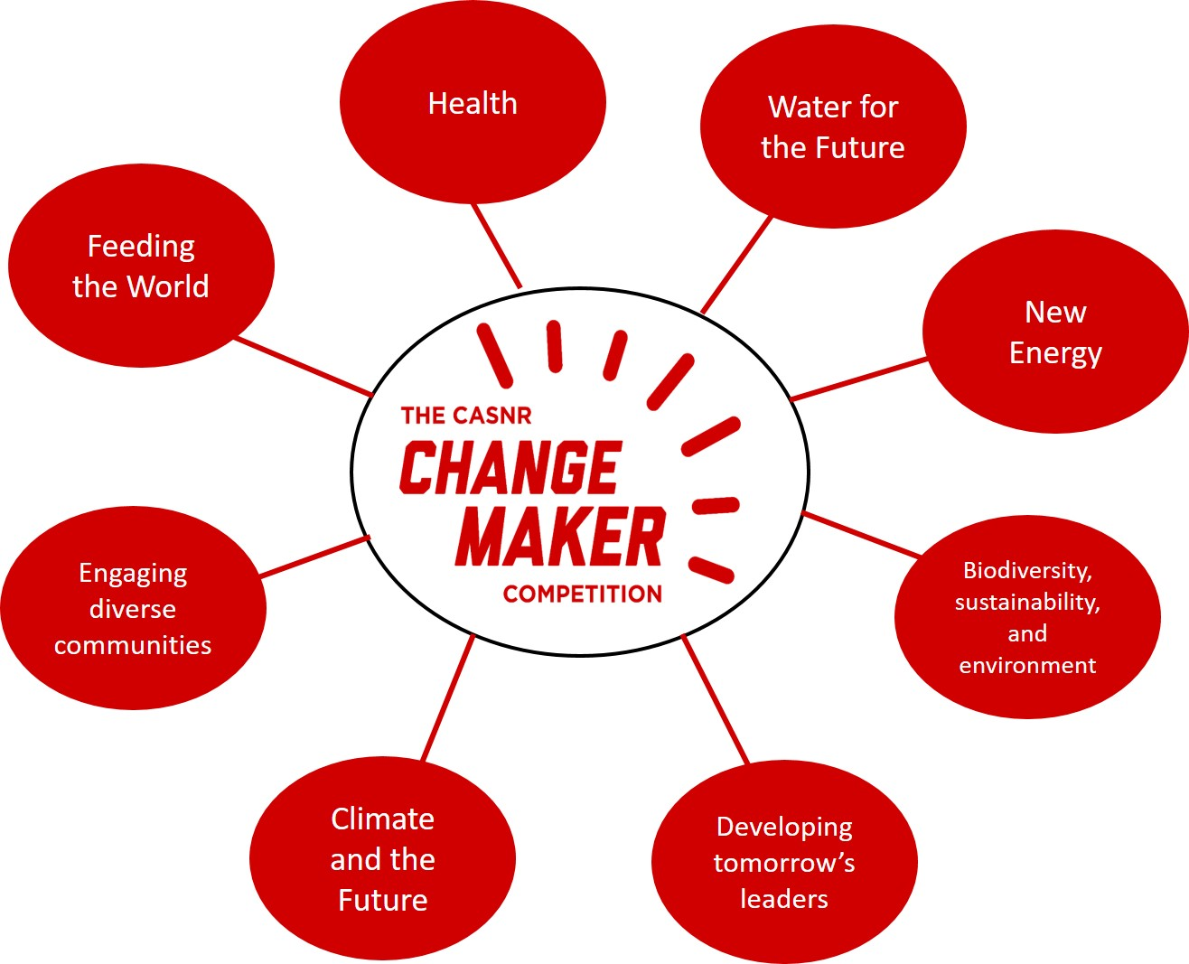
CASNR Change Makers
How Do You Want to Make a Difference in the World?

Slide 5

MANRRS
What is MANRRS?
  Minorities in Agriculture, Natural Resources and Related Sciences
  Student-led org. that welcomes students from all ethnic backgrounds and levels who have an interest in agriculture and related fields
  Fosters and promotes personal and professional development through involvement, networking, and diversity and inclusion
MANRRS at UNL!
  August 2021: Official chapter of National MANRRS Organization established at UNL
  Current Officers
    President: Brytany Gama
    Advisors: Roberto Cortiñas and Megan Rothenberger

Slide 6
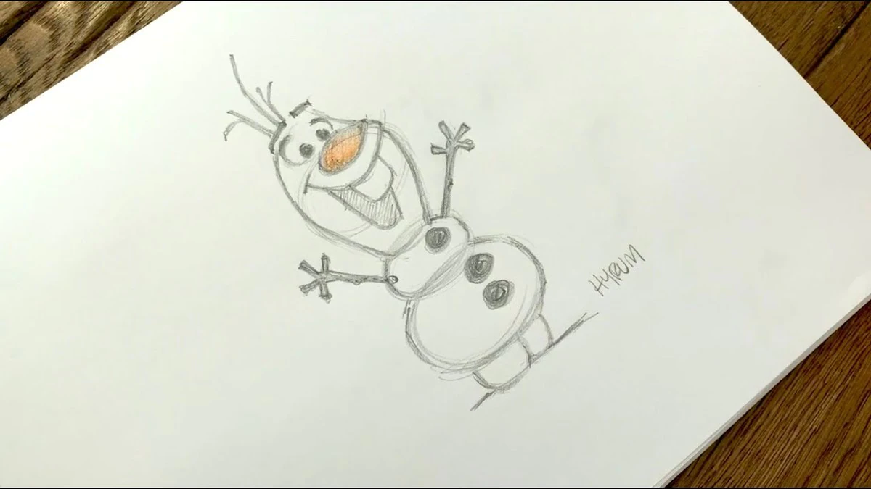
Time for a DRAWING!!!

Slide 7
CASNR Student Success Team
Laura Britten
Coordinator for Student Success, Diversity & Belonging
Megan Rothenberger
Coordinator for Student Success, Health & Well-being
Academic Success
Retention
Start Smart
CASNR CARES
Sense of belonging
Programming
Training & development

Slide 8
CASNR Student Success Team
CASNR CARES: 402-540-3328
CASNR CARES is the first point of contact for students, faculty, staff and parents when there are questions, concerns or situations that affect a student's educational experience at CASNR.
If a student:
Has a family or health emergency and can't attend class
Needs to connect with a UNL service, but doesn't know where to begin
Is struggling emotionally, academically or personally and needs to connect with someone who can help
Has trouble adjusting to college or being away from home
Just needs someone to talk to

Slide 9
CASNR Student Success Team
Jocelyn Gordon
Coordinator for Graduate Student Professional Development
Coordinating individualized student experiences for personal goals and professional growth
Contributing to development and implementation of the following:
Opportunities in career exploration, experiential learning, and professional competencies
Intentional strategies to provide communication and support
Professional Development
Digital Badging
Academic Success
Retention
Programming
Diverse experiences within and beyond UNL

Slide 10
CASNR Student Success Team
CASNR Emerging Leaders in Diversity
Promote inclusive excellence in CASNR students by getting them involved in leadership and diversity initiatives both on and off campus
Participation in group discussions with topics on diversity, equity and inclusion
Focus on their personal, academic, and professional success by working closely with a Student Success Coordinator
Attend group activities, workshops, and seminars to develop awareness and knowledge of diversity issues & leadership skills
Self-awareness, empowerment, and growth

Slide 11

A faculty-staff-student partnership to increase participation of underrepresented groups in (STEM)-related agricultural careers

Slide 12
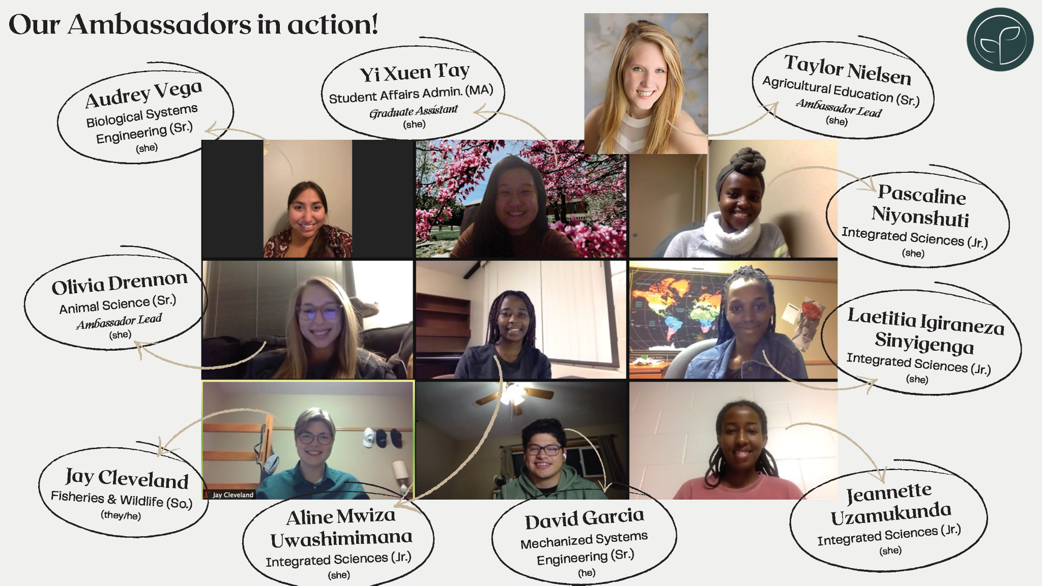

Slide 13


Summer 2021 Book Club
38 Faculty
21 Staff
13 Students

Slide 14

CHS Fellows Program for Ag Educators
Supporting local champions to engage diverse students
Monthly group discussions
Intercultural Competency Development
Reflections on individual, institutional, and community contexts

Slide 15

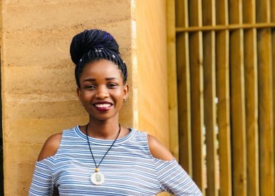
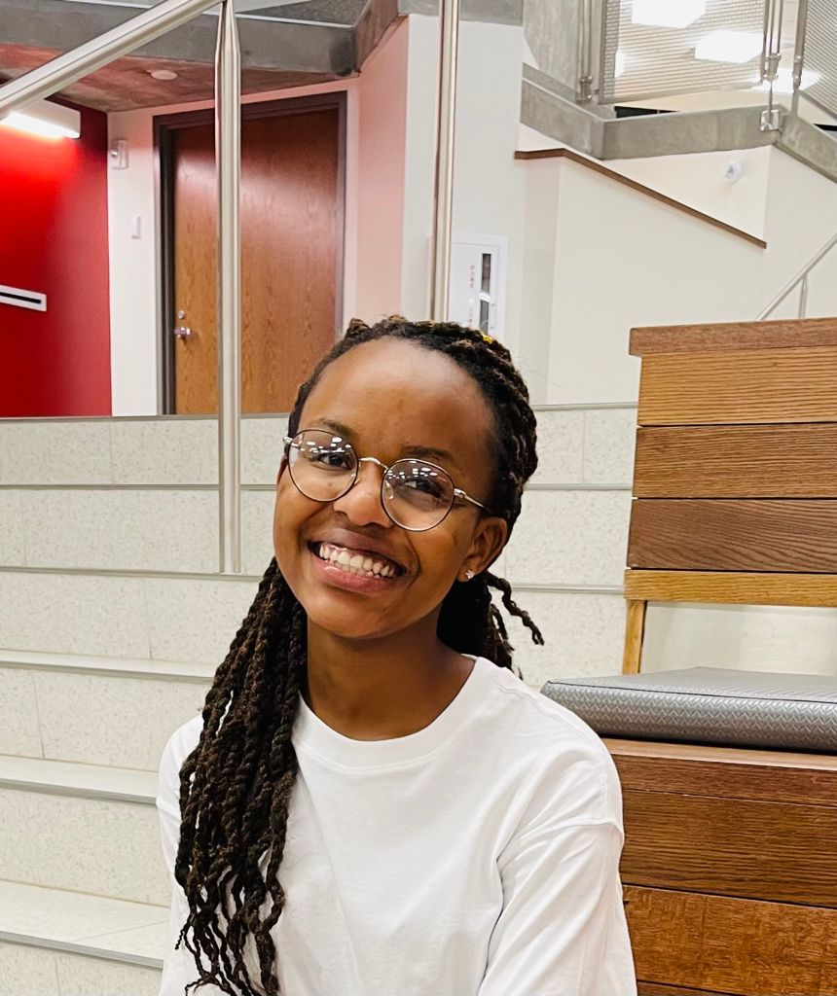
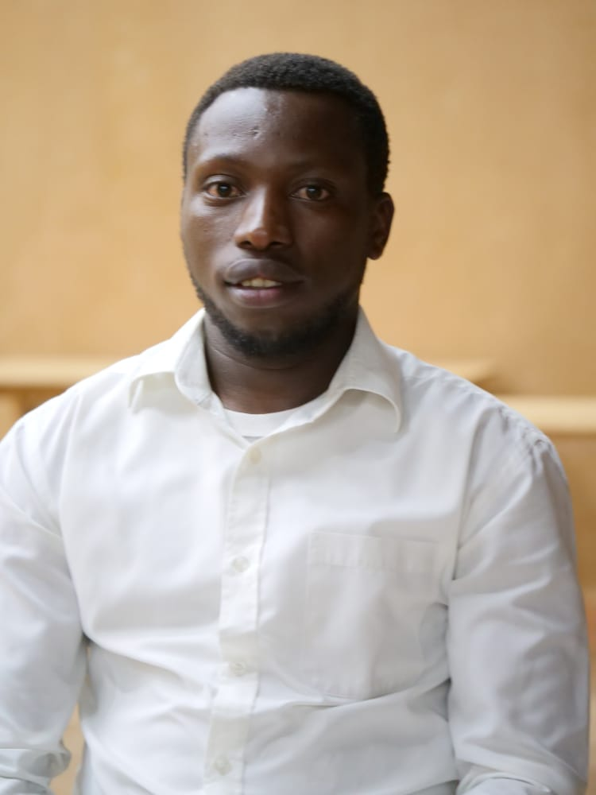
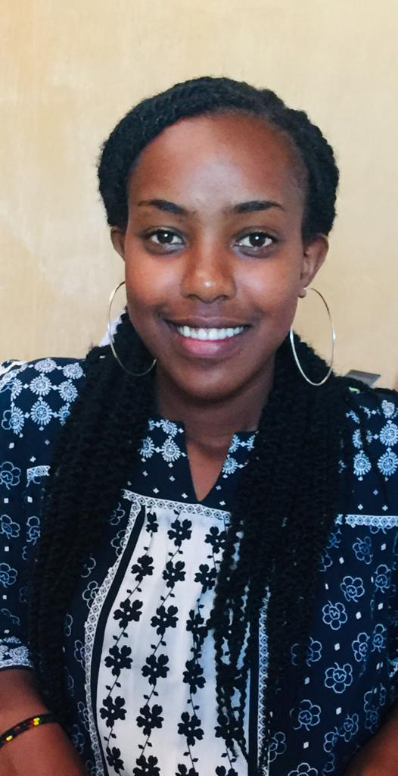
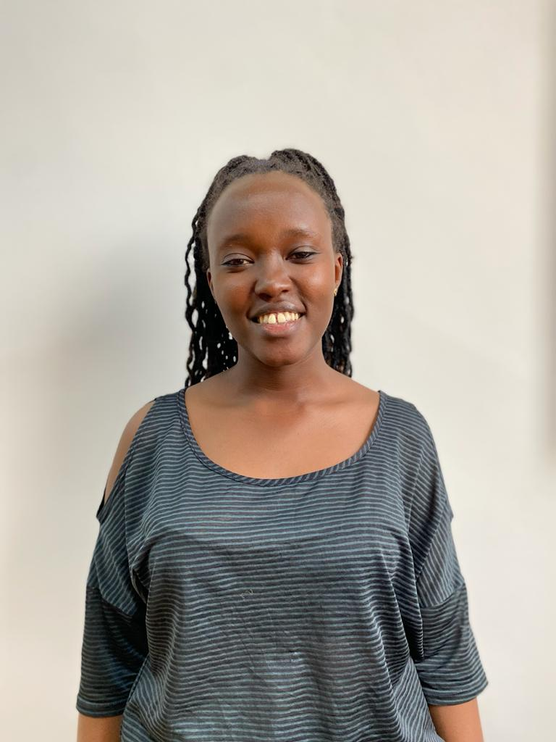
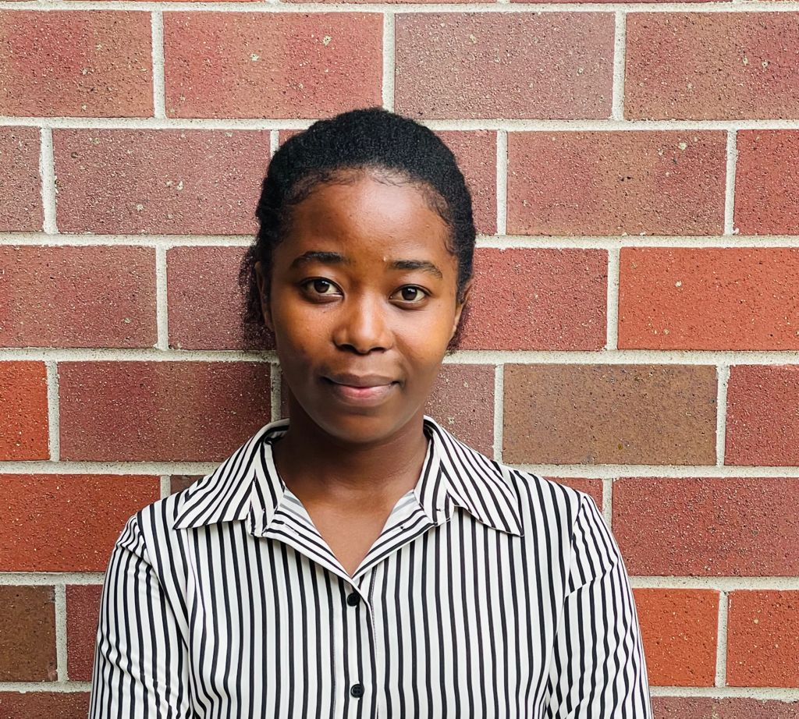
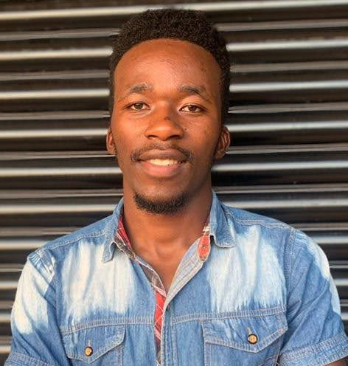
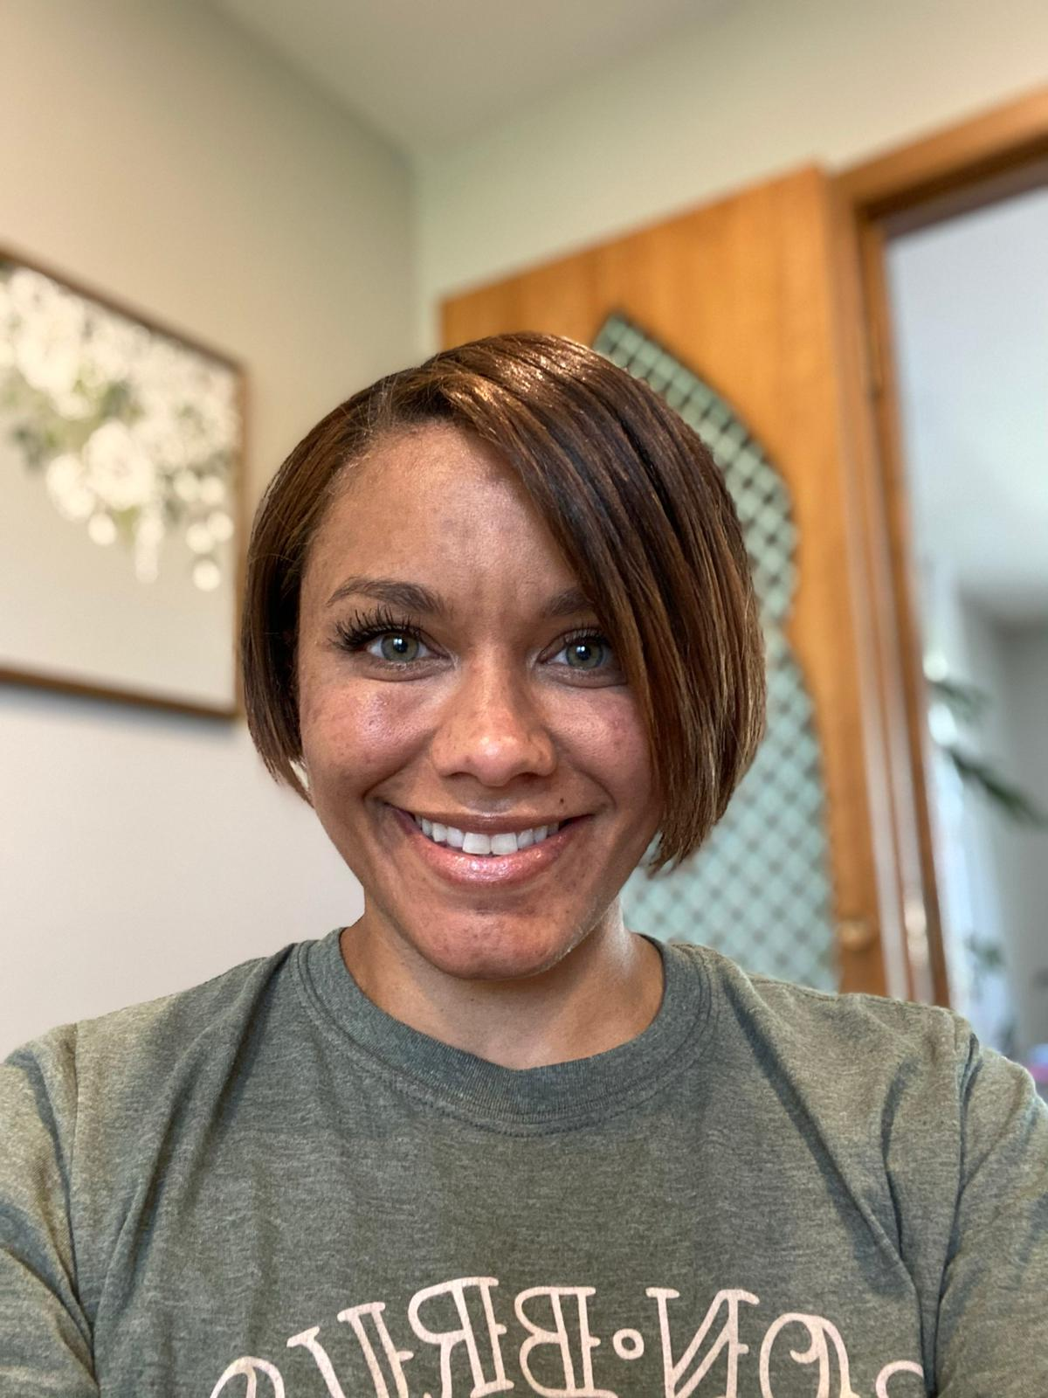

Slide 16

Time for a DRAWING!!!!

Slide 17
CASNR Student Success Team
East Campus Husker Pantry
Located in the Filley Hall Collaboration Space
Tentative soft opening on August 30, 10 hours a week
Partnership with Husker Pantry
Donations can be made in bins across East Campus or through the Amazon
Food, hygiene supplies, school supplies
Cactus Cares partnership with Loeffel Meat Lab

Slide 18
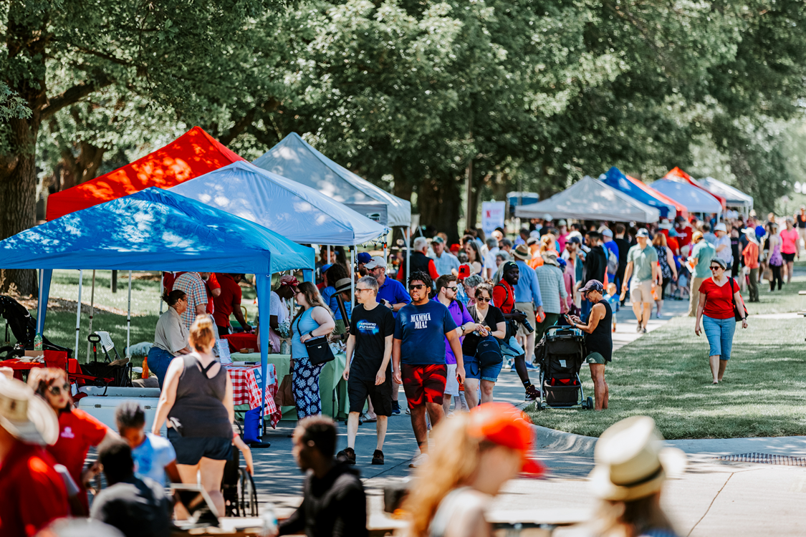
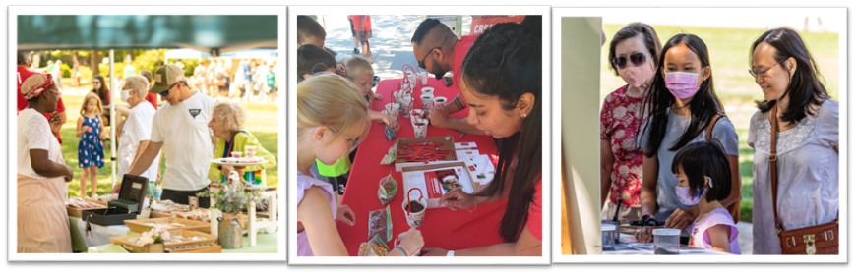

IANR East Campus Discovery Days

Slide 19
Inclusive Classroom Group
WHO: Andrea Basche, Kate Brooks, Christian Elowsky, Helen Fagan, Gina Matkin, Leah Sandall
PURPOSE: We believe human beings are most productive, creative, and engaged when the environment is inclusive. This is exceptionally important in academic environments for students to succeed. We are passionate and motivated to assist CASNR in becoming the most inclusive college on campus.
WHAT: Began Fall 2020, and most recently facilitated a 6-week summer discussion series. Weekly participation averaged 40+ participants made up of faculty, staff and students (representing CASNR and beyond).
IMPACT: Participants dedicated hundreds of hours to their own growth and development and will impact thousands of students in the year ahead.
NEXT STEPS: Badge for Participants; Continue conversation series; and create an accountability structure in partnership with the CASNR Faculty Advisory Council and Dean’s Office.

Slide 20
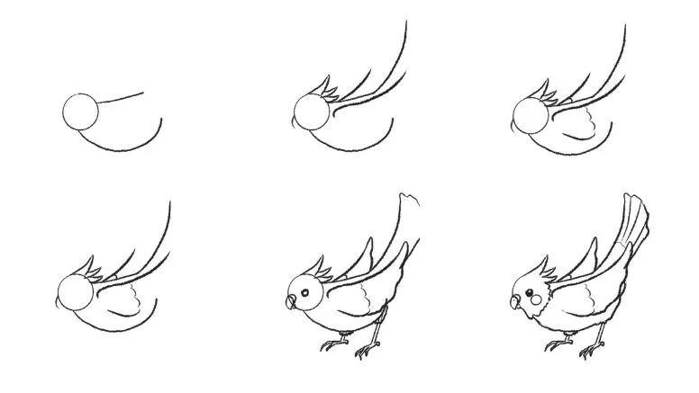
Time for a DRAWING!!!!

Slide 21
Inclusive Excellence Digital Badge
Overarching Goal: Guide participants through collaborative engagement, self-reflection, and goals-planning to draw attention to important language and concepts for incorporating diversity, equity, and inclusion into their personal, academic, and professional activities.
Level 1 – Identity and Terminology
Recognize how personal experiences, values, beliefs influence relationships, attitudes, and behaviors
Distinguish between Diversity, Equity, and Inclusion (JEDI)
Describe key concepts, such as intersectionality, and explain how they support inclusive excellence
Level 2 – Communication and Belonging
Outline how group/social dynamics contribute to a sense of belonging
Integrate inclusive language into your communication practices
Examine your own behaviors, attitudes, and actions and develop strategies for cultivating inclusive environments
Level 3 – Action and Community
Acknowledge the historical context(s) that shape current systems of government and education
Recognize how lived experiences are impacted by workplace culture/environment
Develop strategies for engaging colleagues/supporting inclusivity in your professional activities

Slide 22
Holling Innovative Teaching and Learning Awards
Innovative efforts funded:
Jenny Dauer & Christine Haney: Incorporating Experiential Learning into CASNRs Introductory Core Course, SCIL 101
Jing Zhang, Heejeong Kim, & Limei Zhang: Development, Implementation, and Assessment of a Course-based Undergraduate Research Experiences (CUREs) for an Honors Biochemistry Lab
Lisa Karr, Tom Burkey, Lena Luck, & Kirsten Smith: Animal Science Discovery (ASCId) Program
Jenny Keshwani, Erin Ingram, & Peyton Bishop: Beyond the Box – CASNR Edition

Slide 23
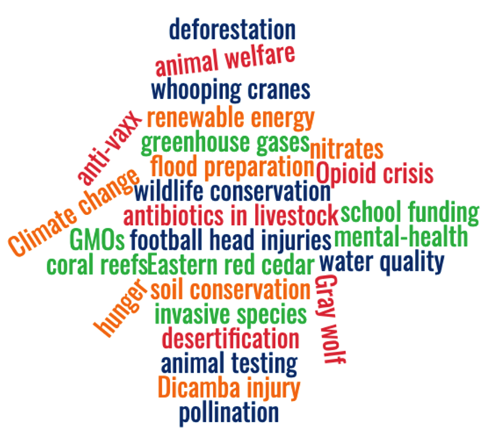
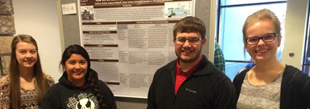


Holling Innovative Teaching and Learning Awards
Incorporating Experiential Learning into SCIL 101, CASNR’s Introductory Core Course
Holling Innovation Award
Jenny Dauer
Christine Haney-Douglass

Slide 24

Time for some CASNR TRIVIA!!!

